Slide 1
Welcome to Best Buddies!
Find a seat with your buddy!

Slide 2
Remind
Social Media
Facebook Group: NVHS Best Buddies 2016-2017
Twitter Username: @bestbuddies_nv
Instagram Username: @nvbestbuddies
Text @amysim to 81010 to get reminders about chapter meetings and monthly events!

Slide 3
Reminder to Peer Buddies!

Slide 4
Chapter Dues
Please write your name on the sheet up front and bring your $20 to give to an officer.

Slide 5
Thank you for everyone that came out to the Floor Hockey Event!

Slide 6
Please take out your phones and email pictures from Best Buddies from this semester!
amysimp116@gmail.com

Slide 7
Holiday Dinner!
When: Wednesday, December 14th
Place: NVHS Cafeteria
Time: 6-8pm
Cost: $5
Registration and Money Due Date: Friday, December 9th
Dress up in your holiday best!
YOU MUST REGISTER TO PARTICIPATE!!
Please bring $5 and registration slip to Ms. Roberts in D141

Slide 8
Pack the Place!!
When: Tuesday, November 22
Where: Main Gym at the Main Building
Time: 7pm?
Poster Due Date (if you are not planning on attending the game): 2:25pm the day of to D141
We have posters to make a sign to cheer for your buddy!

Slide 9
TALENT SHOW!!!!

Slide 10
T-Shirts are in!!!

Slide 11
Craft and Snack

Slide 12
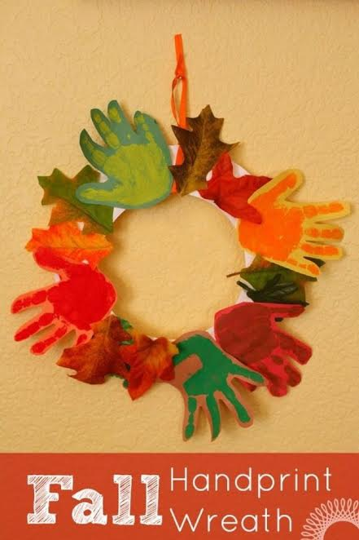
Thanksgiving Wreath
Chips and Water

Slide 13
Next Chapter Meeting is Monday, December 5th!

