Slide 1
Welcome to Best Buddies!
Find a seat with your buddy! Make sure you grab the Buddy Update Packet!

Slide 2
Remind
Social Media
Facebook Group: NVHS Best Buddies 2016-2017
Twitter Username: @bestbuddies_nv
Instagram Username: @nvbestbuddies
Text @amysim to 81010 to get reminders about chapter meetings and monthly events!

Slide 3
Chapter Dues
Please write your name on the sheet up front and bring your $20 with to give to an officer.

Slide 4
Sharko’s Fundraiser!
Thanks for everyone who came out!

Slide 5
Halloween Dance!
When: Saturday, October 22nd
Place: WVHS Cafeteria
Time: 6-8pm
Cost: $15
Permission Slip Due Date: Wednesday, October 19th (turn into Ms. Michaels in room D143)
Permission Slip Online

Slide 6
Special Needs PTA Event
We are looking for around 10 volunteers to help with a Special Needs PTA Event! It is Saturday, October 8th from 9:30-2:30 at the Freshman Center. You do not have to commit to the whole time, though!

Slide 7
Craft and Snack

Slide 8
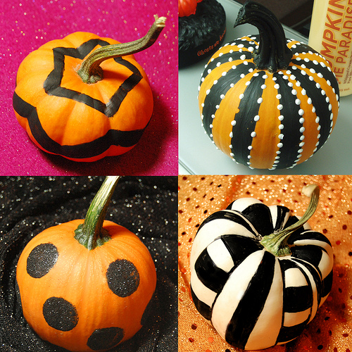
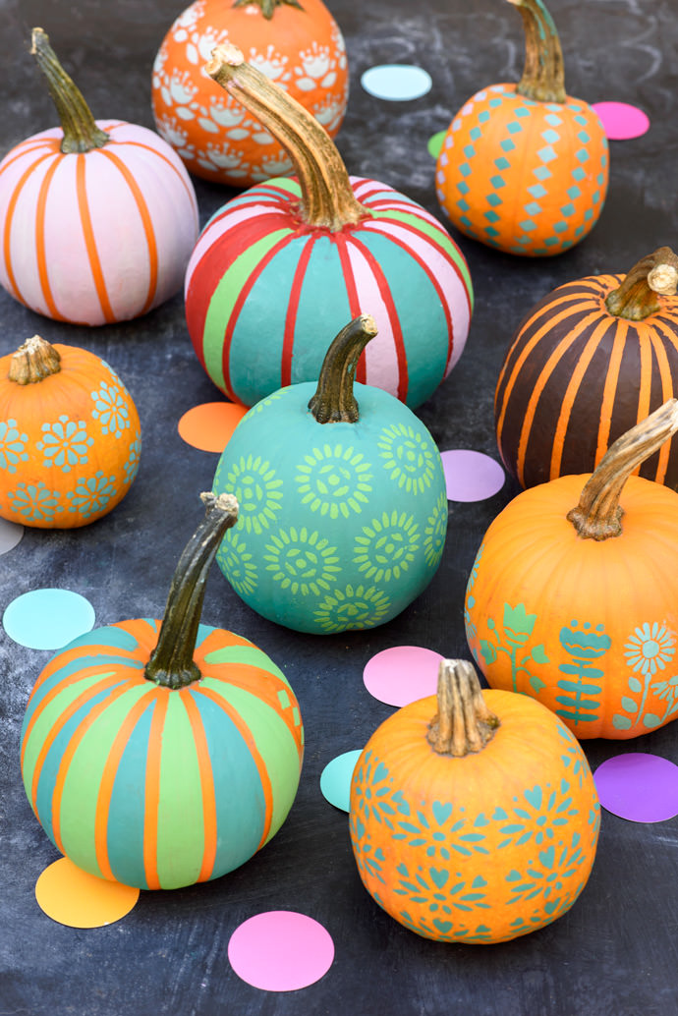
Painting Pumpkins

Slide 9
Halloween-Themed Trail Mix

